Slide 1
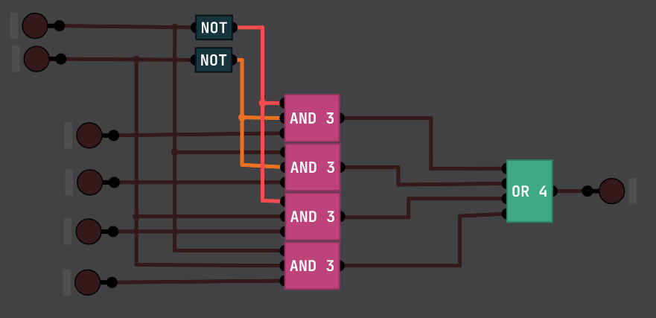
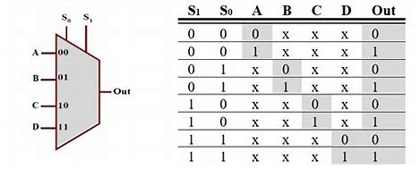
TITLE :
Implementation of Sequential and Combination Circuit in
Digital Logic Simulator
OBJECTIVE :
To design and simulate basic digital components using logic
Simulator
THEORY :
4 : 1 MUX :
2) 1 : 4 DEMUX :

Slide 2
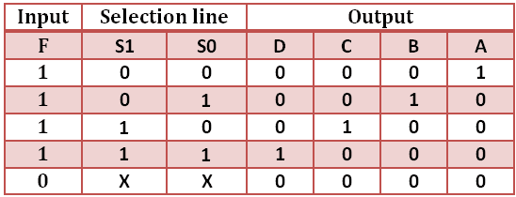
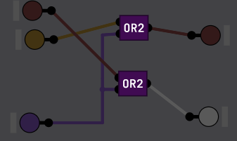
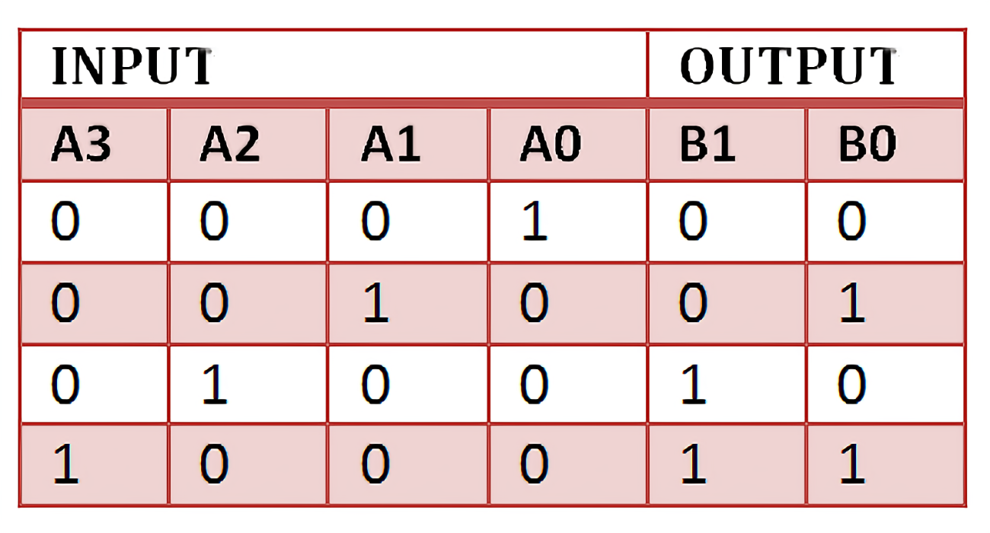
3) 4 : 2 Encoder :

Slide 3
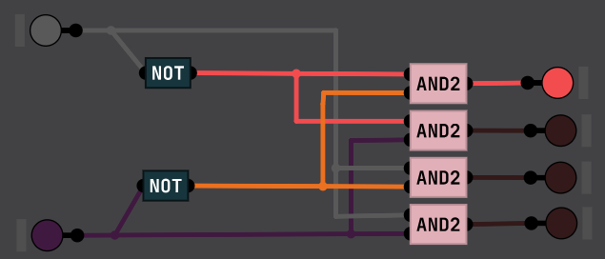
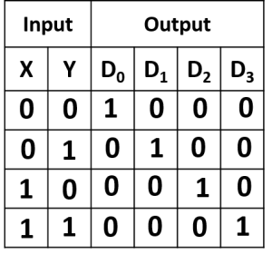
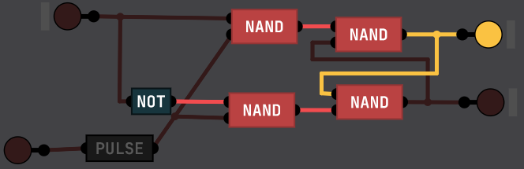
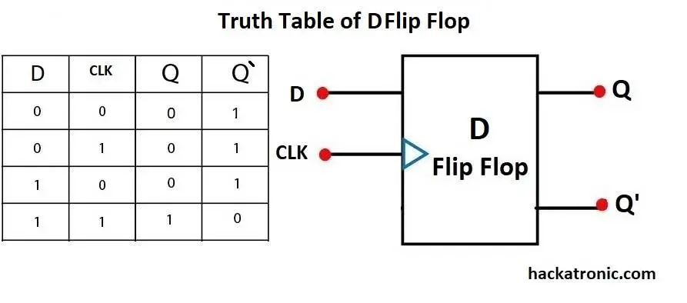

4) 4 : 2 Decoder :
5) D Flip Flop :

Slide 4
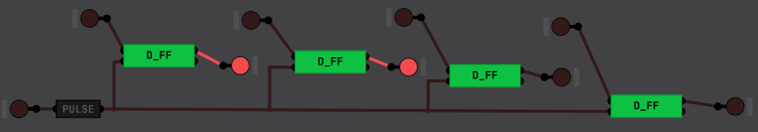
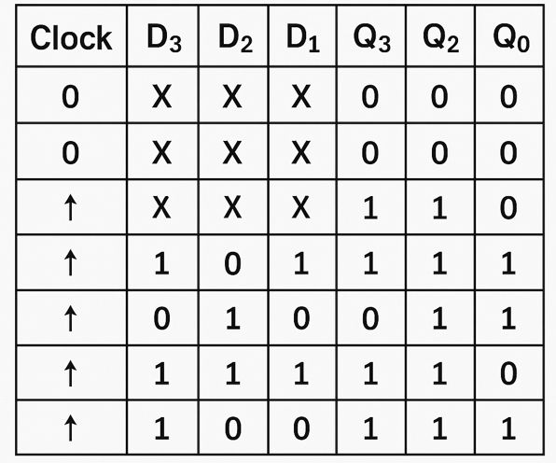
6) 4-bit PIPO Register :
DISSCUSSION & CONCLUSION :
The implementation of sequential and combinational circuits in a digital logic simulator successfully demonstrated the functionality of key components, including a 4-bit PIPO register, MUX, DEMUX, encoder, and decoder. Challenges such as synchronization and optimization were resolved through iterative testing, ensuring reliable operation. The project validated the effectiveness of digital simulation in understanding circuit behavior and signal processing, providing a strong foundation for further exploration of advanced digital components and enhancing overall design and analytical skills in digital systems.

